Slide 1


Unit 5: Culture spot 5
Native Americans

Slide 2
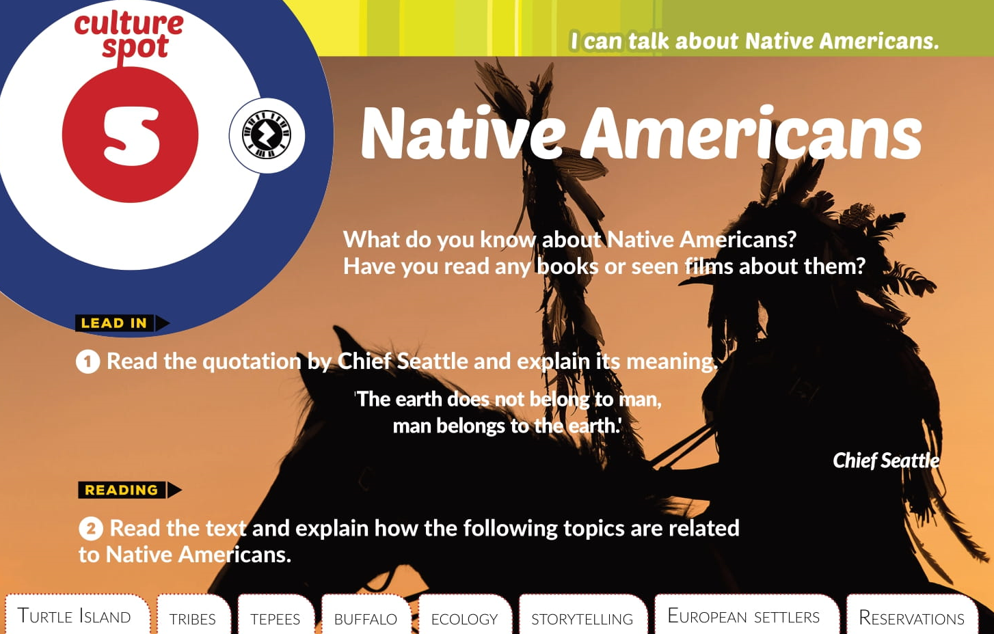

Slide 3
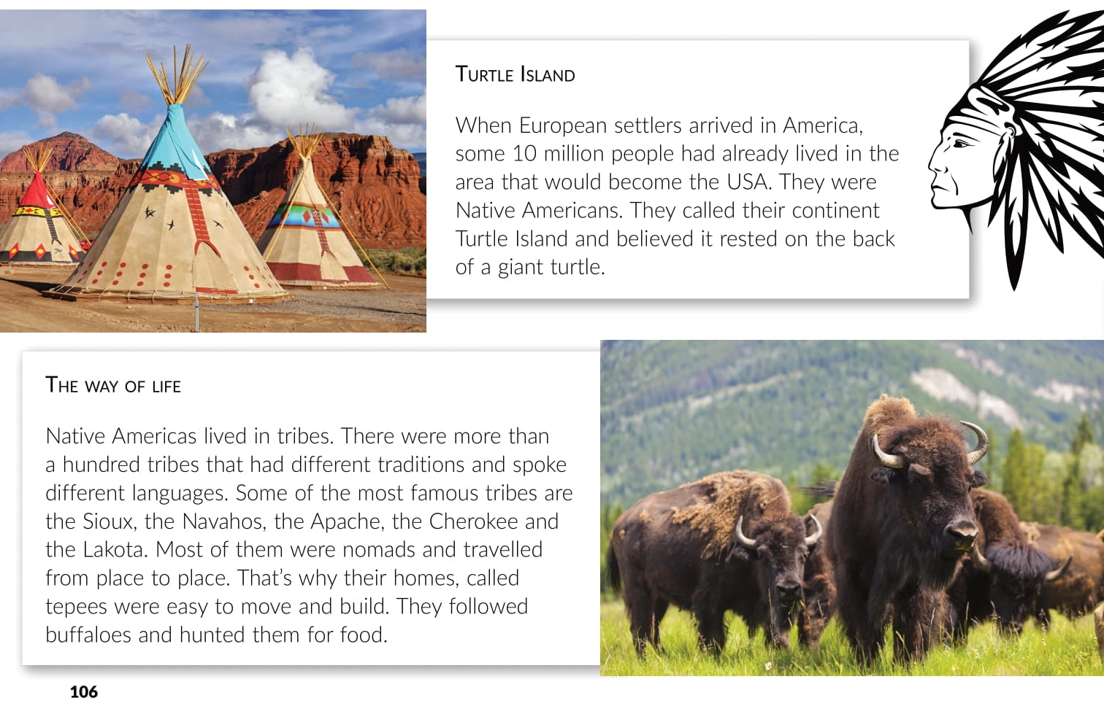

Slide 4
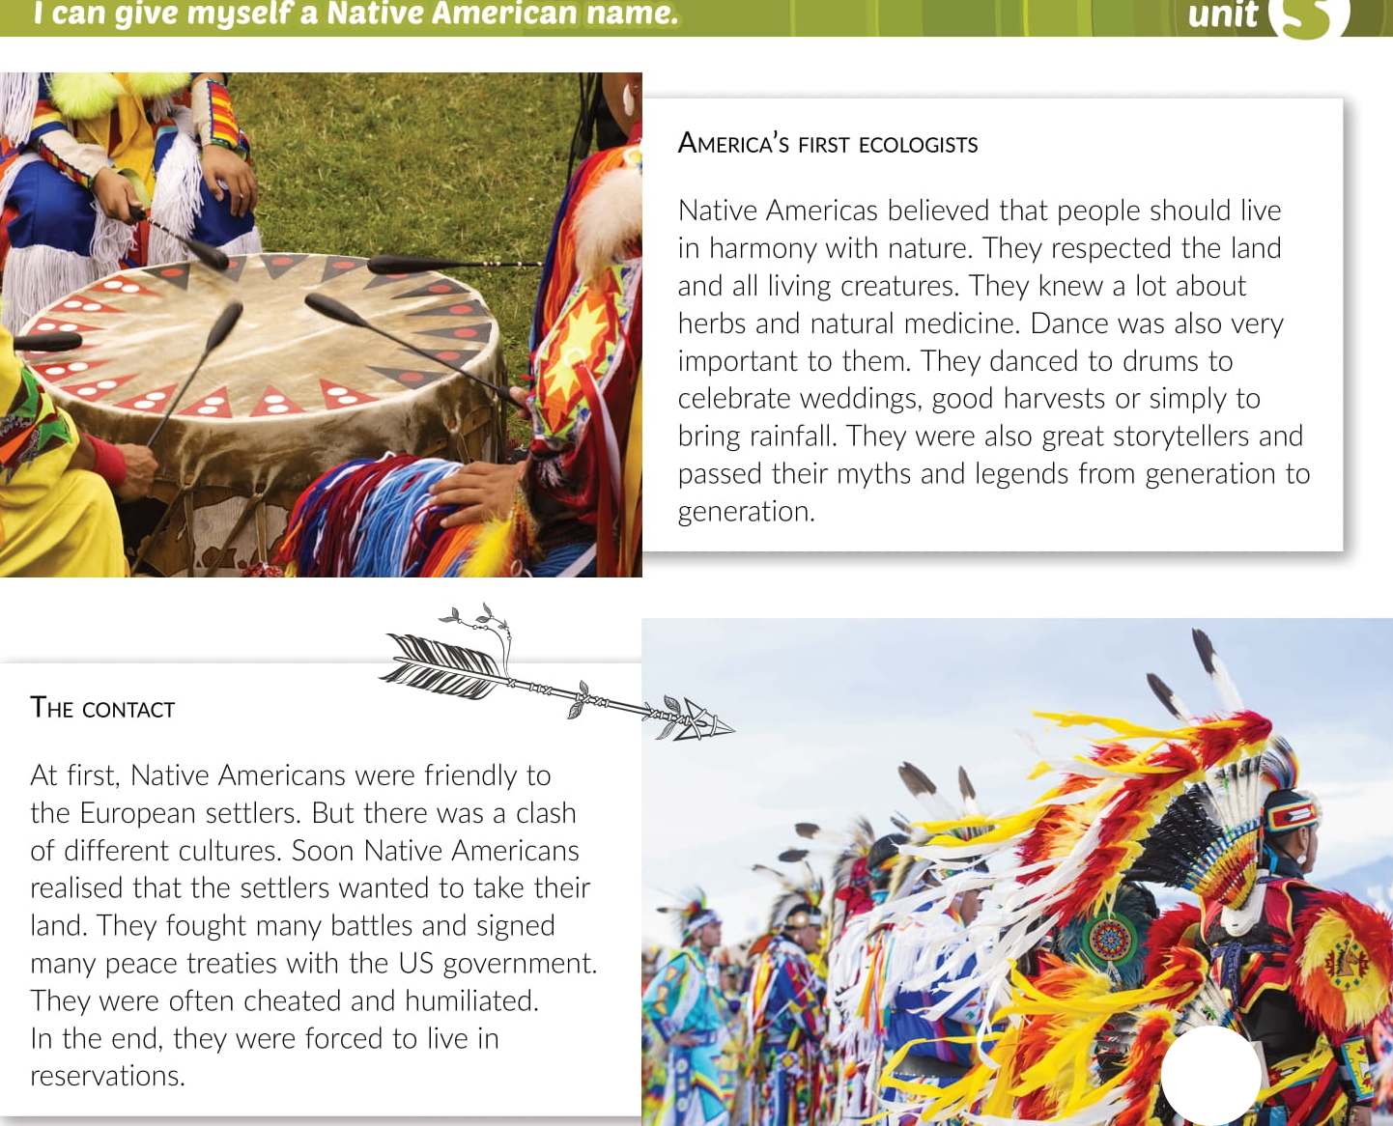

Slide 5

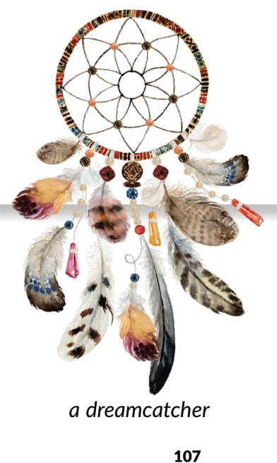


Slide 6
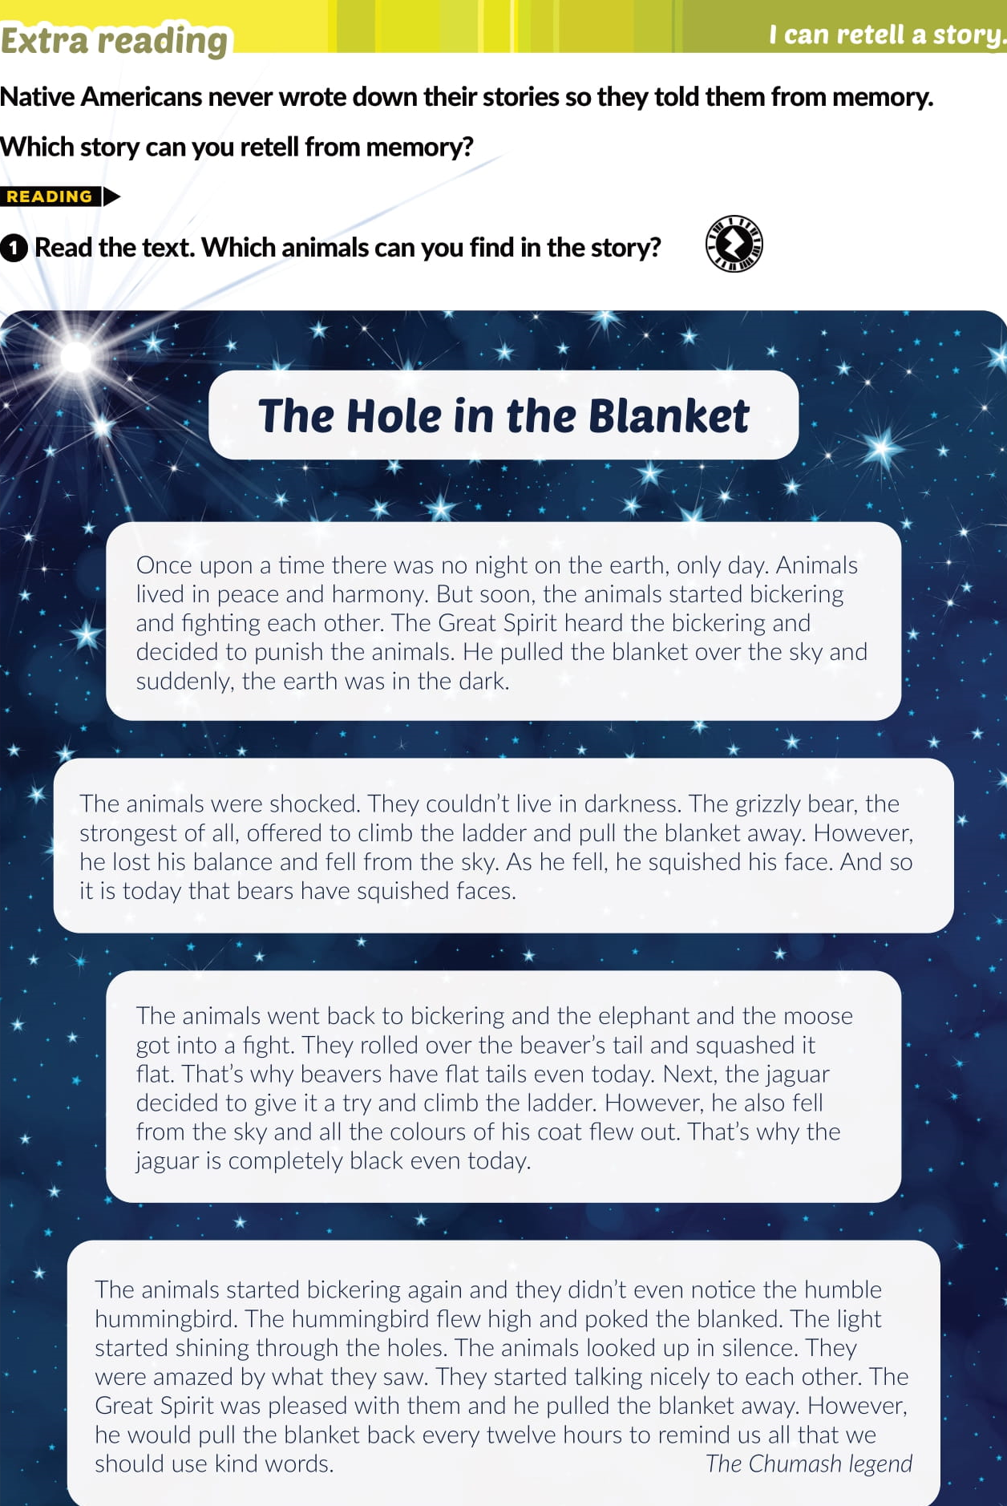


Slide 7
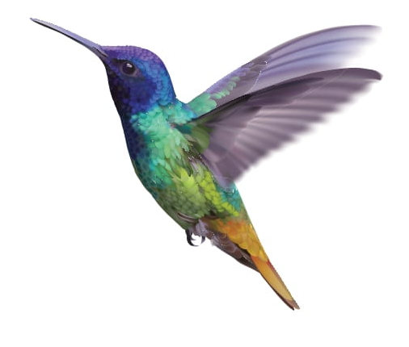
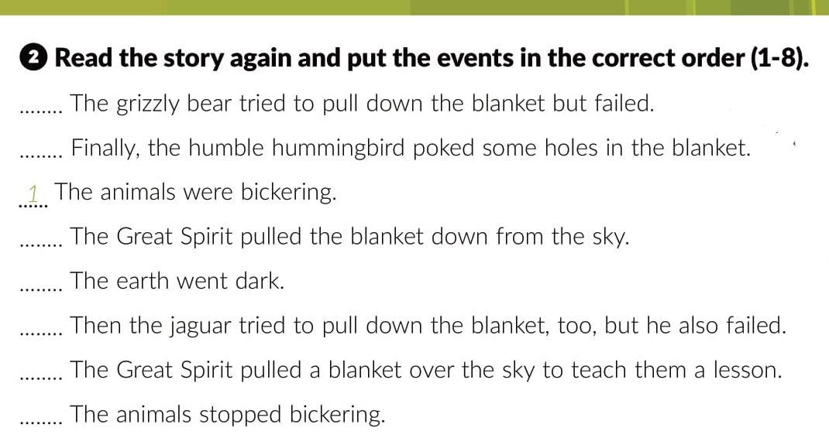
4
6
7
3
5
2
8

Slide 8
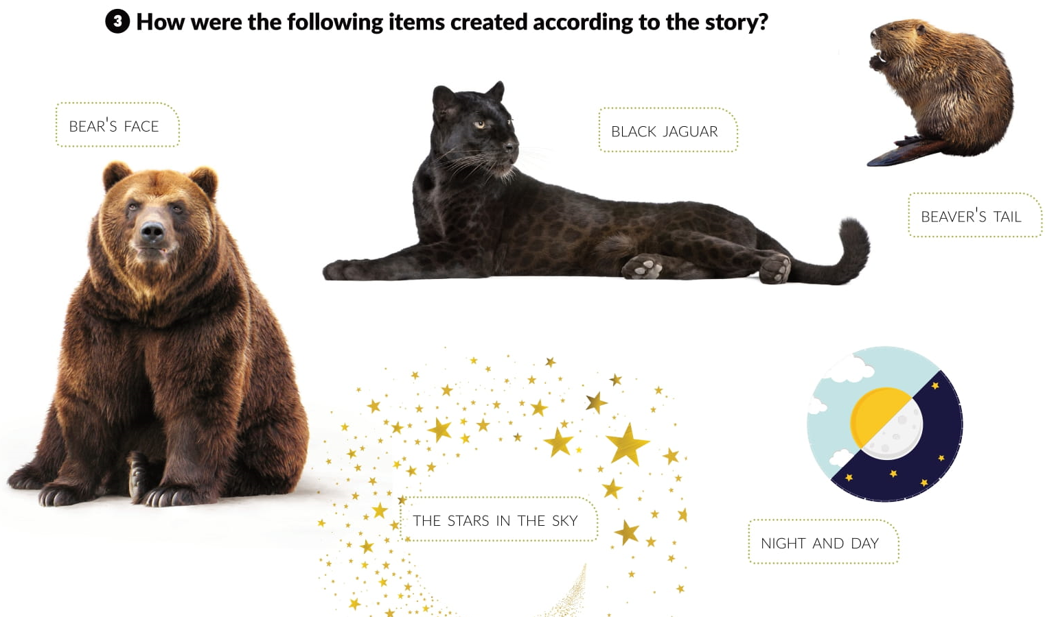

Slide 9



Slide 10


Slide 11


Slide 12
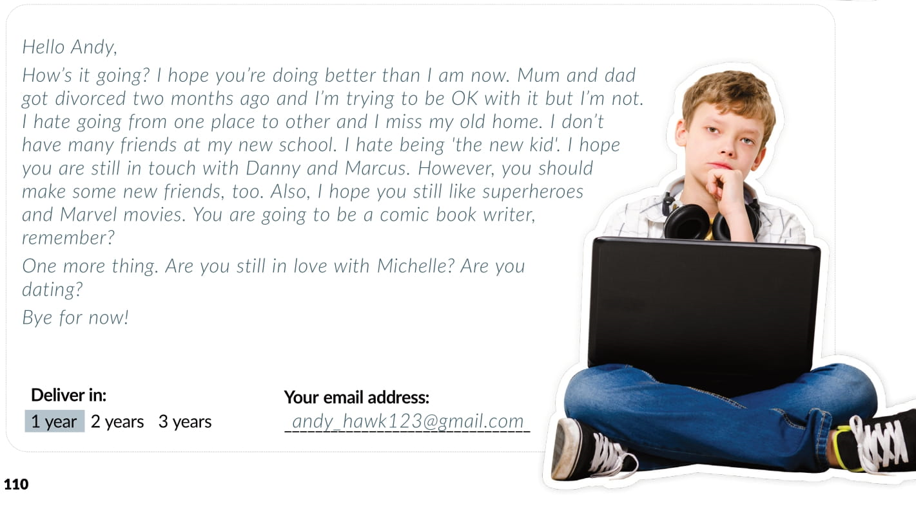

Slide 13


Slide 14
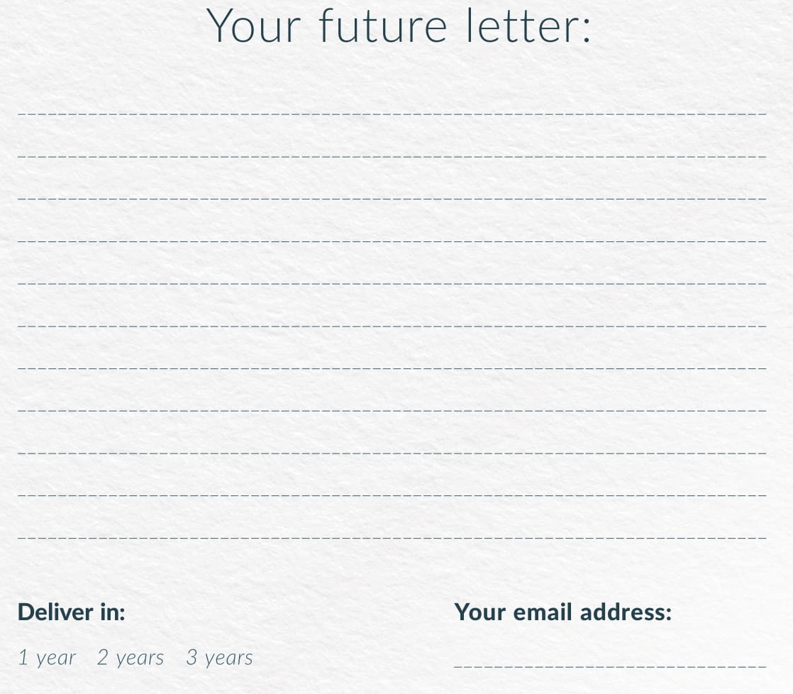

Slide 15
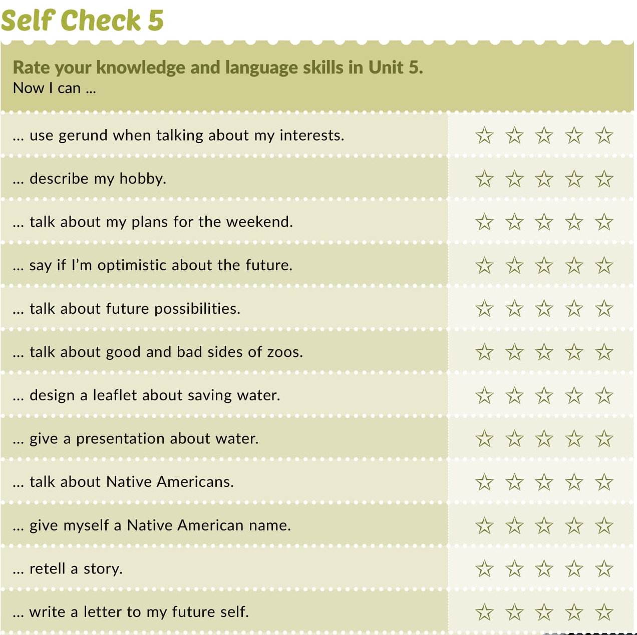

Slide 16


Slide 17

Otvori sljedeću poveznicu, te odaberi LEARN MORE
Culture spot 5 Native Americans | Way to go 4 (e-sfera.hr)

